Slide 1

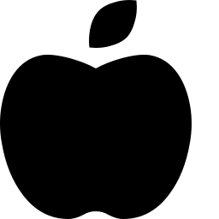
AI DIET RECOMMENDATION SYSTEM
Age • BMI • Disease Type • Activity Level
Personalized Nutrition Guidance Powered by Machine Learning
AI Powered
ML Based
Instant Results
Flask Web App
Capstone Project | Machine Learning & Web Development

Slide 2




The Problem
Generic diet advice doesn't work for everyone
One-Size-Fits-All Advice
Health Conditions Are Overlooked
Most diet plans ignore individual differences in age, weight, and health conditions.
People with diabetes, hypertension, or obesity need very different nutrition strategies.
Activity Level Rarely Considered
Manual Planning Is Time-Consuming
A sedentary person and an athlete have vastly different dietary requirements.
Consulting a nutritionist for every change in lifestyle is slow, costly, and inaccessible.
02

Slide 3


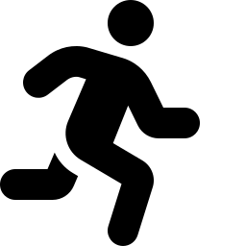
Our Solution
A web-based AI Nutrition Assistant that instantly generates a personalized diet plan using a trained Machine Learning model — analyzing Age, BMI, Disease Type, and Physical Activity Level to recommend the most suitable diet category.
Recommended Diet
Balanced Diet
Recommended
Avoid
1. User Input
• Fruits
• Vegetables
• Whole Grains
• Nuts
• Dairy
• Fast Food
• Fried Foods
• Soft Drinks
• Junk Food
• Excess Sugar
Age, BMI, disease type & activity level
2. ML Prediction
Encoded features passed to trained model
3. Diet Output
Water Intake
Activity
Personalized diet plan with food guidance
2.5–3 Litres
30 Min Walk
03

Slide 4


Key Features
AI Powered Engine
ML-Based Predictions
Instant Results
A trained ML classification model drives every recommendation.
Learns patterns from real health & nutrition data to classify diets.
Recommendation generated in real time after form submission.
Personalized Guidance
Actionable Food Lists
Responsive Interface
Considers age, BMI, disease, and activity — not generic advice.
Clear 'recommended' vs 'avoid' food guidance for each diet type.
Clean, modern UI that adapts to desktop and mobile screens.
04

Slide 5
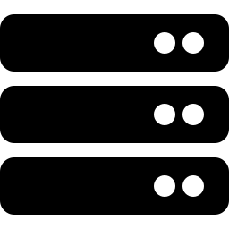


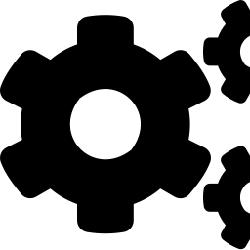
Technology Stack
Flask
Scikit-learn Model
Jinja2 Templating
Python micro-framework serving routes & rendering templates
Pre-trained classifier saved & loaded via Pickle (.pkl)
Dynamic HTML rendering with conditional diet content
Label Encoders
HTML / CSS
NumPy
Encode Disease, Activity & Diet categories for the model
Custom-styled glassmorphism UI with responsive layout
Structures user input into model-ready feature arrays
05

Slide 6
System Architecture
User Form
Flask Route
/predict
Encoders
ML Model
Diet Decoder
Rendered Result
Age, BMI, Disease,
Activity Level
Reads form data,
validates input
Disease & Activity
Label Encoding
model.predict()
classification
Inverse-transform to
diet label
index.html shows
plan + guidance
End-to-end pipeline: raw form input becomes a structured, human-readable diet plan in milliseconds.
06

Slide 7
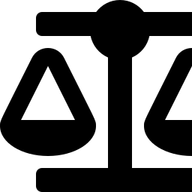
Inside the Machine Learning Model
Input Features
Output: Diet Classes
Age
Balanced Diet
Patient's age in years
Low Sodium Diet
BMI
Body Mass Index (numeric)
Trained Classifier
High Protein Diet
(saved as .pkl via Pickle)
Disease Type
Diabetic Diet
Encoded via LabelEncoder
Low Carb Diet
Activity Level
Encoded via LabelEncoder
07

Slide 8
Choosing the Right Model
Multiple classifiers were trained and compared on accuracy before final selection
Logistic Regression Selected
Logistic Regression matched the top tree-based models on accuracy (~99%) while staying simpler, faster to train, and easier to interpret — making it the ideal choice for a lightweight Flask deployment.
KNN trailed well behind at ~52% accuracy and was ruled out.
08

Slide 9
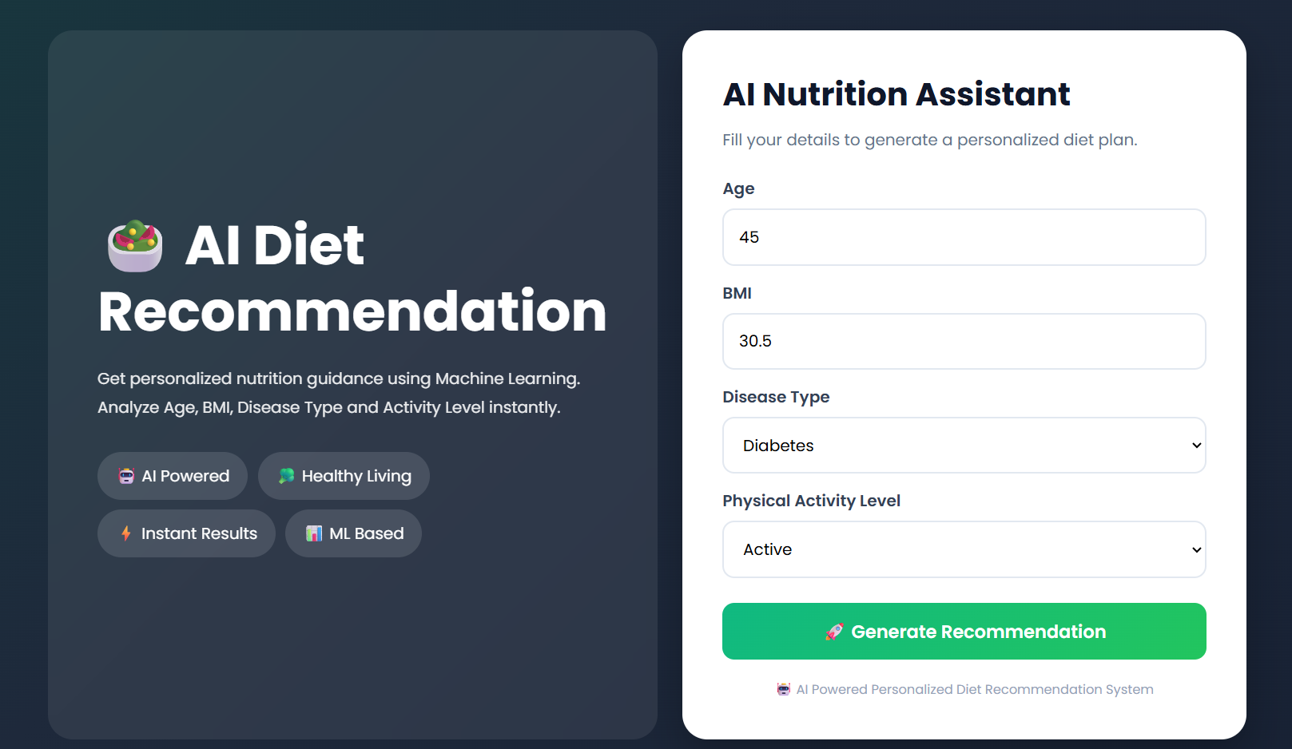
Interface Walkthrough — Input Form
Simple Form
Just four inputs — age, BMI, disease type, activity level.
Guided Selection
Dropdowns populated dynamically from the trained encoders.
One-Click Prediction
Submitting instantly triggers the ML model via Flask.
09

Slide 10
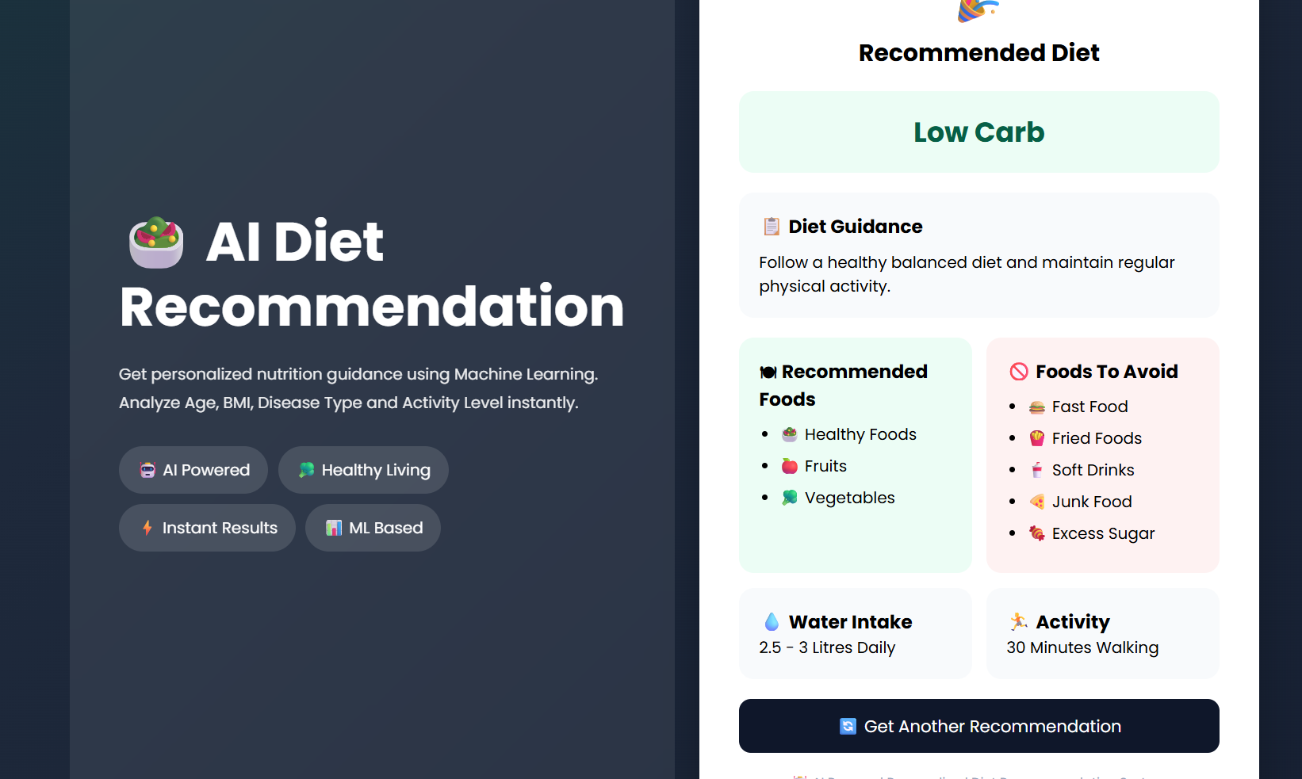
Interface Walkthrough — Recommendation Output
Diet Category
The predicted diet class is shown as the headline result.
Food Guidance
Recommended foods and foods to avoid, side by side.
Lifestyle Add-ons
Daily water intake and activity suggestions included.
Try Again
A single click regenerates a fresh recommendation.
10

Slide 11
Diet Categories & Guidance
Low Sodium Diet
High Protein Diet
Balanced Diet
Diabetic Diet
Fresh vegetables, fruits & fish for healthy blood pressure.
Eggs, chicken, fish & beans for muscle growth & recovery.
A healthy mix of proteins, carbs & fats for overall wellness.
Low-glycemic foods to help manage blood glucose levels.
Avoid
Avoid
Avoid
Avoid
Salt, chips, processed foods
Sugary foods, soft drinks, cakes
Fast food, fried foods, excess sugar
Sweets, chocolate, sugary drinks
11

Slide 12
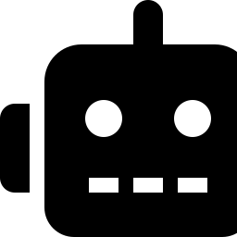


Future Enhancements
Mobile Application
Calorie & Macro Tracking
Conversational Chatbot
Extend the assistant to a native Android/iOS experience.
Let users log meals and track progress over time.
A chat interface for follow-up questions and swaps.
Wearable Integration
Larger, Richer Dataset
Explainable Recommendations
Pull real-time activity & vitals from fitness trackers.
Retrain on more diverse health & regional food data.
Show *why* a diet was recommended for trust & clarity.
12

Slide 13
Thank You
AI Diet Recommendation System — turning raw health data into personalized, actionable nutrition guidance.
Questions & Discussion

